Slide 1
CS 31007 Autumn 2020 COMPUTER ORGANIZATION AND ARCHITECTURE
Instructors
Rajat Subhra Chakraborty
Bhargab B. Bhattacharya
Week 5, September 28, 2020
Indian Institute of Technology Kharagpur
Computer Science and Engineering
Notes:
Good Morning!
The title of today’s talk is “On some Planar Partitioning Problems”.

Slide 2
So far covered …
Evolution and history of computer design
Basic components of a computer
Instruction Set Architecture (ISA)
CPU Performance
MIPS Instruction Set, Programming
Acknowledgement: Patterson and Hennessy
Notes:
Good Morning!
The title of today’s talk is “On some Planar Partitioning Problems”.

Slide 3
The Instruction Set: a Critical Interface
Quick Review
software
instruction set
hardware

Slide 4
Computer Design Approach
System software
(OS, Compiliers)
System software
(OS, Compiliers)
Instruction Set Architecture (ISA)
Instruction Set Architecture (ISA)
Computer Organization
Computer Organization
Bottom-up approach:
Hardware first, ISA later
Top-down approach to hardware design:
ISA first, hardware later

Slide 5
What determines the execution time of a machine/assembly-level program P when it is run on a machine M?
P consists of a number of machine-level instructions (IC: instruction count);
Each machine instruction requires several clock cycles to complete (CPI: average number of clock cycles per instruction);
Each clock cycle has certain time period (CCT: clock cycle time)
Thus, CPU-time = IC × CPI × CCT
(CPU Performance Equation)

Slide 6
Amdahl’s Law
CPU-time_{new} = CPU-time_{old} × (1 - Frac_{enhanced}) + Frac_{enhanced}
Speed-up_{enhanced}
CPU-time_{old}
CPU-time_{new}
1
Speed-up_{overall} =
=
(1 - Frac_{enhanced}) + Frac_{enhanced}
Speed-up_{enhanced}
Law of diminishing return: unaffected fraction will determine the limiting case!
Improvement of larger fraction will yield higher overall speed-up → Make the common case faster

Slide 7
Execution Cycle
Obtain instruction from memory
Instruction
Fetch
Instruction
Decode
Determine required actions and instruction size
Operand
Fetch
Locate and obtain operand data from memory/register
Execute
Compute result value or status
Result
Store
Deposit results in register/memory for later use
operand-address computation
Next
Instruction
Determine successor instruction
computer arithmetic, ALU design

Slide 8
Chapter 3
Today’s Agenda
Arithmetic for Computers

Slide 9
Arithmetic for Computers
§3.1 Introduction
Operations on integers
Addition and subtraction
Multiplication and division
Dealing with overflow
Hardware implementation of ALU
Floating-point real numbers
Representation and operations
Overflow and underflow
Hardware implementation of FP-operations

Slide 10
MIPS Example
C code:
f = (g + h) - (i + j);
f, …, j in $s0, …, $s4
Compiled MIPS code:
add $t0, $s1, $s2 add $t1, $s3, $s4 sub $s0, $t0, $t1
Amdahl
Make common operations faster …

Slide 11
Arithmetic needs a number system
Bits carry no inherent meaning —steps in execution cycle define relationship between bits and their meaning
Binary numbers (base 2)
0000 0001 0010 0011 0100 0101 0110 0111 1000
Things to remember: number of bits is finite (finite-precision arithmetic)
what about overflow? fractions and real numbers negative numbers
How do we represent negative integers, real numbers?

Slide 12
Possible Representations
Sign Magnitude One's Complement Two's Complement
000 = +0 000 = +0 000 = +0 001 = +1 001 = +1 001 = +1 010 = +2 010 = +2 010 = +2 011 = +3 011 = +3 011 = +3
100 = -0 100 = -3 100 = -4 101 = -1 101 = -2 101 = -3 110 = -2 110 = -1 110 = -2 111 = -3 111 = -0 111 = -1
Issues: balance, number of zeros, ease of operations
Which one is suitable for computer arithmetic?

Slide 13
Number Dial: Signed-Magnitude Representation
-
A 4-bit signed-magnitude number representation system for integers
What is the range of representable numbers when n-bits are available?

Slide 14
2’s-Complement Number Dial
4-bit 2’s-complement number representation system for integers

Slide 15
2’s-Complement Number Systems
Evaluation of 2’s complement representation as decimal number

Slide 16
MIPS
32 bit signed numbers (2’s complement) 0000 0000 0000 0000 0000 0000 0000 0000_{two} = 0_{ten}
0000 0000 0000 0000 0000 0000 0000 0001_{two} = + 1_{ten}
0000 0000 0000 0000 0000 0000 0000 0010_{two} = + 2_{ten} ... 0111 1111 1111 1111 1111 1111 1111 1110_{two} = + 2,147,483,646_{ten}
0111 1111 1111 1111 1111 1111 1111 1111_{two} = + 2,147,483,647_{ten}
1000 0000 0000 0000 0000 0000 0000 0000_{two} = – 2,147,483,648_{ten}
1000 0000 0000 0000 0000 0000 0000 0001_{two} = – 2,147,483,647_{ten}
1111 1111 1111 1111 1111 1111 1111 1111_{two} = – 1_{ten}
maxint
minint
What is the range of representable 2’s complement numbers when n-bits are available?

Slide 17
Two's Complement Operations
Negating a two's complement number: invert all bits and add 1
remember: “negate” and “invert” are quite different!
Converting an n-bit number into an equivalent number with more than n-bits (sign-extension):
MIPS 16-bit “immediate” gets converted to 32-bits for arithmetic
copy the most significant bit (the sign bit) and replicate it towards MSB
0010 (+2) -> 0000 0010 (+2) 1010 (-6) -> 1111 1010 (-6)

Slide 18
Example: MIPS Instruction Hardware needs to perform sign-extension before executing addition
An example of MIPS M/L instruction:
Total length of the instruction – 32 bits; opcode: 6 bits;
$t0, $s1 -> 32-bit CPU registers (ID: 5-bit each, as there are a total of 32 such registers); immediate value is provided as a 16-bit 2’s complement integer;
Add 5 to the content of $s1 and save the result in $t0
addi $t0, $s1, 5
op
s1
t0
Immediate
6 bits
5 bits
5 bits
16 bits
001000
10001
01000
0000000000000101

Slide 19
Addition & Subtraction
Just like in grade school (carry/borrow 1s) 0111 0111 0110 + 0110 - 0110 - 0101
Two's complement operations easy
subtraction using addition of negative numbers 0111 + 1010
Overflow (result too large for finite computer word):
e.g., result of an arithmetic operation on two n-bit numbers exceeds the range of representable numbers Note that overflow term is somewhat misleading, it does not mean a carry has “overflowed”

Slide 20
Signed-Magnitude vs 2’s-Complement
Signed-magnitude adder/subtractor is significantly complex
2’s-complement adder/subtractor needs very little hardware other than a simple adder

Slide 21
Dilemma of Carry and Overflow
Decimal
2’s Complement
Decimal
2’s Complement
-1
1111
0
0000
-2
1110
universe:
4-bit 2’s complement arithmetic
1
0001
-3
1101
2
0010
-4
1100
3
0011
-5
1011
4
0100
-6
1010
5
0101
-7
1001
6
0110
-8
1000
7
0111
0 1 0 0
(+4)
1 1 0 0
(-4)
1 0 0 0
(-8)
0 1 0 0
(+4)
+
1 0 1 1
(-5)
+
0 1 1 0
(+6)
+
1 0 0 0
(-8)
+
0 1 0 0
(+4)
1 1 1 1
(-1)
1 0 0 1 0
(+2)
1 0 0 0 0
(0)
1 0 0 0
(-8)
no carry;
no overflow;
result correct
carry discarded;
result still correct;
no overflow
carry √;
overflow √;
result invalid
no carry;
overflow √;
result invalid

Slide 22
Hazards of Finite-Precision Arithmetic:
Detecting Overflow for Integer Operations
No overflow when adding a positive and a negative number
No overflow when signs are the same for subtraction
Overflow occurs when the value affects the sign:
overflow when adding two positives yields a negative
or, adding two negatives gives a positive
or, subtract a negative from a positive and get a negative
or, subtract a positive from a negative and get a positive
Consider the operations A + B, and A – B
Can overflow occur if B is 0 ?
Can overflow occur if A is 0 ?

Slide 23
Hazards of Finite-Precision Arithmetic
Compute: X = A + B – C; A, B, C are +ve integers;
X = (A + B) – C
Or,
X = A + (B – C) ?
The first choice might cause overflow – invalid result
The second option is safer

Slide 24
CS 31007 Autumn 2020 COMPUTER ORGANIZATION AND ARCHITECTURE
Instructors
Rajat Subhra Chakraborty
Bhargab B. Bhattacharya
Week 5, September 29, 2020
Indian Institute of Technology Kharagpur
Computer Science and Engineering
Notes:
Good Morning!
The title of today’s talk is “On some Planar Partitioning Problems”.

Slide 25
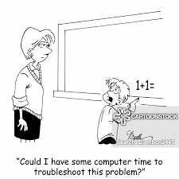
Computer Arithmetic
?

Slide 26
Overflow Detection Logic: Hardware Solution
sign-bit
A: a_{n-1}, a_{n-2}, ……, a₁, a₀
B: b_{n-1}, b_{n-2}, ……, b₁, b₀
+
S: s_{n-1}, s_{n-2}, ……, s₁, s₀
Overflow = a_{n-1}b_{n-1}s_{n-1} + a_{n-1}b_{n-1} s_{n-1}
overflow → adding two positives yields a negative
or, adding two negatives gives a positive
In MIPS, on detecting overflow, interrupt (exception) is invoked;
add, addi (overflow considered); addu, addiu (overflow ignored)

Slide 27
Overflow Detection Logic: Another Solution
Carry into MSB ° Carry out of MSB
For a N-bit ALU: Overflow = CarryIn[N - 1] XOR CarryOut[N - 1]
CarryIn0
A0
1-bit
ALU
Result0
X
Y
X XOR Y
B0
CarryOut0
0
0
0
CarryIn1
A1
0
1
1
1-bit
ALU
Result1
1
0
1
B1
CarryOut1
1
1
0
CarryIn2
A2
1-bit
ALU
Result2
B2
CarryIn3
A3
Overflow
1-bit
ALU
Result3
B3
CarryOut3
Show that these two solutions are logically equivalent

Slide 28
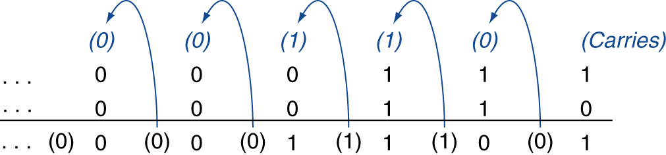
Integer Addition
Example: 7 + 6
§3.2 Addition and Subtraction
Overflow if result out of range
Adding +ve and –ve operands, no overflow
Adding two +ve operands
Overflow if result sign is 1
Adding two –ve operands
Overflow if result sign is 0

Slide 29
Integer Subtraction
Add negation of second operand
Example: 7 – 6 = 7 + (–6)
+7: 0000 0000 … 0000 0111 –6: 1111 1111 … 1111 1010 +1: 0000 0000 … 0000 0001
Overflow if result out of range

Slide 30
Dealing with Overflow
Some languages (e.g., C) ignore overflow
Use MIPS addu, addui, subu instructions
Other languages (e.g., Ada, Fortran) require raising an exception
Use MIPS add, addi, sub instructions
On overflow, invoke exception handler
Save PC in exception program counter (EPC) register
Jump to predefined handler address
mfc0 (move from coprocessor reg) instruction can retrieve EPC value, to return after corrective action

Slide 31
Hardware for Arithmetic
Where we've been:
Performance (seconds, cycles, instructions)
Abstractions: Instruction Set Architecture Assembly Language and Machine Language
What's up ahead:
Implementing the Architecture
operation
a
32
ALU
result
32
b
32

Slide 32
Why Adders?
Addition: a fundamental operation
Basic block of most arithmetic operations
Address calculation
Faster, faster and faster
How?
Architectural-level optimization
Gate-level optimization
Speed/area trade-off

Slide 33
Review: 1-bit adder
One-bit Half Adder:
One-bit Full Adder:
A B Sum C_{out}
0 0 0 0
0 1 1 0
1 0 1 0
1 1 0 1
A
B
Sum = A ⊕ B
C_{out} = A.B
HA
C_{out}
Sum
C_{in} A B Sum C_{out}
0 0 0 0 0
0 0 1 1 0
0 1 0 1 0
0 1 1 0 1
1 0 0 1 0
1 0 1 0 1
1 1 0 0 1
1 1 1 1 1
A
B
Sum = A ⊕ B ⊕ C_{in}
C_{out} = A.B + B.C_{in} + A.C_{in}
FA
C_{out}
C_{in}
Sum
Notes:
Can we use HA to add two n-bit numbers? No! Carry propagation.

Slide 34
One-Bit Full-Adder (FA) Implementation
C_{out} = A.B + B.Cin + A. C_{in}
= A.B + C_{in}. (A+B)
Sum = A ⊕ B ⊕ C_{in}
A
A
B
Sum
B
C_{out}
C_{in}
C_{in}
A
A
B
B
C_{out}
FA
C_{in}
Sum
HMK: Implement FA using only nine 2-input NAND-gates;
only uncomplemented inputs (A, B, C_{in}) are available.

Slide 35
n-bit Ripple-Carry Adder (RCA)
To add two n-bit numbers
A: a_{n-1}, a_{n-2}, ……, a₁, a₀
B: b_{n-1}, b_{n-2}, ……, b₁, b₀
a_{n-1}
b_{n-1}
a₂
b₂
a₁
b₁
a₀
b₀
Flat Combinational Logic
Inputs: a_{n-1}, a_{n-2}, ……, a₁, a₀ ,b_{n-1}, b_{n-2}, ……, b₁, b₀
Outputs: s_{n-1}, s_{n-2}, ……, s₁, s₀, c_{n}
FA
. . .
FA
FA
FA
C_{n}
C₀
s_{n-1}
s₂
s₁
s₀
A
B
N-bit RCA delay = n * δ
δ = (delay of 1-bit FA)
C_{out}
FA
C_{in}
Sum
Critical path in an n-bit ripple-carry adder
→ CCT needs to accommodate long delay
Cost = O(n); delay O(n)
Notes:
What is C0? C_n?
This architecture is called Ripple-carry adder: the simplest!
Carry delay is important

Slide 36
4-bit Ripple-Carry Addition: Example
A=0011
0
0
0
1
1
0
1
1
B=0101
A₃
B₃
A₂
B₂
A₁
B₁
A₀
B₀
C₄
FA
C₃
FA
C₂
FA
C₁
FA
C₀
0
S₃
S₂
S₁
S₀
T=0
0
0
0
0
0
0
0
0
S=0000
T=1
0
0
0
1
0
1
1
0
S=0110
T=2
0
0
0
1
1
0
1
0
S=0100
T=3
0
0
1
0
1
0
1
0
S=0000
T=4
0
1
1
0
1
0
1
0
S=1000
delay = 4 units; also, overflow has occurred
Notes:
The time unit is the delay for one full adder to compute its S and Cout signals
What is the meaning of the intermediate (T=1..3) values of S?
How long should the clock period be?
What effect does the carry chain delay have on the clock frequency?

Slide 37
Subtraction using 2’s complement

Slide 38
Multi-Bit Adders

Slide 39
Ripple-Carry Adder
Chain 1-bit adders together
Carry ripples through the entire chain
Disadvantage: slow

Slide 40
Possible solutions to mitigate
carry-propagation delay
1. Detect the end of carry propagation rather than wait for
the worst-case time
2. Speed-up propagation using techniques such as
lookahead
carry-select
logarithmic adder
3. Limit carry propagation to within a small number of bits
4. Trade-off: speed (or inversely, delay) versus logic cost

Slide 41
Adder
Several types of carry-propagate adders (CPAs) are:
Ripple-carry adders (slow)
Carry-lookahead adders (fast)
Prefix adders (faster)
Carry-lookahead and prefix adders are faster for large adders but require more hardware
Symbol

Slide 42
Carry Lookahead Adder (CLA): Basic Idea
ith-bit
A: a_{n-1}, a_{n-2}, .., a_{i}…, a₁, a₀
B: b_{n-1}, b_{n-2}, .., b_{i} ,…,b₁, b₀
+
S: s_{n-1}, s_{n-2}, ……, s₁, s₀
carry-bit c_{i}
At the ith stage, carry will be generated for propagation to the next stage if and only if
a_{i} = b_{i} = 1; => g_{i} = a_{i} b_{i} ==> carry-generate function
or either a_{i} or b_{i} = 1, and previous carry c_{i -1} arrives here;
=> p_{i} = a_{i} + b_{i} => carry-propagate function

Slide 43
Carry-Lookahead Adder
Generate all carry bits directly from inputs, instead of rippling through FA-blocks sequentially
Few notation:
Generate (g_{i}) and propagate (p_{i}) signals for each bit:
A column will generate a carry out if a_{i} AND b_{i} are both 1.
g_{i} = a_{i} b_{i}
A column will propagate a carry in to the carry out if A_{i} OR B_{i} is 1.
p_{i} = a_{i} + b_{i}
The carry out of a column (C_{i}) is:
c_{i+1} = a_{i} b_{i} + (a_{i} + b_{i} )c_{i} = g_{i} + p_{i} c_{i}

Slide 44
Carry-Lookahead Adder
We can visualize the carry “generate” and “propagate” functions from another perspective:
C_{i+1} = a.b + b. c_{in} + a. c_{in}
= a.b + c_{in}. (a+b)
A column will generate a carry out if a_{i} AND b_{i} are both 1, i,e., g_{i} = a_{i} b_{i}
A column will propagate a carry if A_{i} or B_{i} is 1, i.e.,
p_{i} = a_{i} + b_{i}
The carry out of a column (C_{i}) is:
c_{i+1} = a_{i} b_{i} + (a_{i} + b_{i} )c_{i} = g_{i} + p_{i} c_{i}

Slide 45
Carry-Lookahead Adder
Idea:
Produce c_{i} ahead of time instead of passing through (i-1) stages
Bit position
Carry
A
B
Sum
7 6 5 4 3 2 1 0
1 0 0 1 1 1 1
0 1 0 0 1 1 0 1 +
0 1 0 0 0 1 1 1
1 0 0 1 0 1 0 0
FA
FA
FA
FA
FA
Instead of RCA, use independent 1-bit FA-modules
no signal propagation through stages
Notes:
In the example,
By looking at (A4,B4), we can say for sure that C5=0, no matter what C4 is.
By looking at (A2,B2), we can say for sure that C3=1.
C3, “generated” by (A2,B2) (or by A0,B0 if you wish), “propagated” as far as C4, and then got “killed” by (A4,B4)
The idea is, can we look at A(3..0) and B(3..0) and determine the value of C4 in one shot?

Slide 46
Carry-Lookahead Adder
RCA
A₃
B₃
A₂
B₂
A₁
B₁
A₀
B₀
C₄
FA
C₃
FA
C₂
FA
C₁
FA
C₀
S₃
S₂
S₁
S₀
CLA
A₃
B₃
A₂
B₂
A₁
B₁
A₀
B₀
C₃
C₂
C₁
C₄
FA
FA
FA
FA
C₀
S₃
S₂
S₁
S₀
Instead of RCA, use n independent 1-bit FA-modules working in parallel;
no signal propagation through stages; directly generate all
carry-bits from inputs
Notes:
In the example,
By looking at (A4,B4), we can say for sure that C5=0, no matter what C4 is.
By looking at (A2,B2), we can say for sure that C3=1.
C3, “generated” by (A2,B2) (or by A0,B0 if you wish), “propagated” as far as C4, and then got “killed” by (A4,B4)
The idea is, can we look at A(3..0) and B(3..0) and determine the value of C4 in one shot?

Slide 47
Basic Signals
Generate signal: g_{i} = a_{i}b_{i}
Propagate signal: p_{i} = a_{i} + b_{i}
Carry recurrence
c_{i+1} = g_{i} + c_{i}p_{i}

Slide 48
Unrolling Carry Recurrence
c_{i} = g_{i-1} + c_{i-1}p_{i-1} =
= g_{i-1} + (g_{i-2} + c_{i-2}p_{i-2})p_{i-1} = g_{i-1} + g_{i-2} p_{i-1} + c_{i-2}p_{i-2}p_{i-1} =
= g_{i-1} + g_{i-2} p_{i-1} + (g_{i-3} + c_{i-3}p_{i-3})p_{i-2}p_{i-1} =
= g_{i-1} + g_{i-2} p_{i-1} + g_{i-3} p_{i-2}p_{i-1} + c_{i-3}p_{i-3}p_{i-2}p_{i-1} =
= ….. =
= g_{i-1} + g_{i-2} p_{i-1} + g_{i-3} p_{i-2}p_{i-1} + g_{i-4}p_{i-3}p_{i-2}p_{i-1} + ….. +
+ g₀p₁p₂…p_{i-2}p_{i-1} + c₀p₀p₁p₂…p_{i-2}p_{i-1} =
= g_{i-1} + ∑ g_{k} ∏ p_{j} + c₀ ∏ p_{j}
i-2
i-1
i-1
k=0
j=k+1
j=0

Slide 49
4-bit Carry-Lookahead Adder
c₄ = g₃ + g₂ p₃ + g₁ p₂p₃ + g₀p₁p₂p₃ + c₀p₀p₁p₂p₃
c₃ = g₂ + g₁ p₂ + g₀ p₁p₂ + c₀p₀p₁p₂
g_{i} = a_{i}b_{i}
p_{i} = a_{i} + b_{i}
c₂ = g₁ + g₀ p₁ + c₀p₀p₁
c₁ = g₀ + c₀ p₀
s₀ = x₀ ⊕ y₀ ⊕ c₀ = p₀ ⊕ c₀
s₁ = p₁ ⊕ c₁
s₂ = p₂ ⊕ c₂
s₃ = p₃ ⊕ c₃

Slide 50
Carry Lookahead Adder
one AND-gate and
one OR-gate
C₁ = a₀b₀ + (a₀+b₀)c₀ = g₀ + p₀c₀
C₂ = a₁b₁ + (a₁+b₁)c₁ = g₁ + p₁c₁ ₌ g₁ + p₁g₀ ₊ p₁p₀c₀
C₃ = a₂b₂ + (a₂+b₂)c₂ = g₂ + p₂c₂ ₌ g₂ + p₂g₁ ₊ p₂p₁g₀ ₊ p₂p₁p₀c₀
C₄ = a₃b₃ + (a₃+b₃)c₃ = g₃ + p₃c₃ ₌ g₃ + p₃g₂ ₊ p₃p₂g₁ ₊ p₃p₂p₁g₀ ₊ p₃p₂p₁p₀c₀
g_{i} = a_{i}b_{i} p_{i} = a_{i} + b_{i}
inputs
a₃ b₃
a₂ b₂
a₁ b₁
a₀ b₀
g₃
p₃
g₂
p₂
g₁
p₁
g₀
p₀
CLA logic
c₀
c₄
c₃
c₂
c₁
carry-bits

Slide 51
Carry Generation Logic

Slide 52
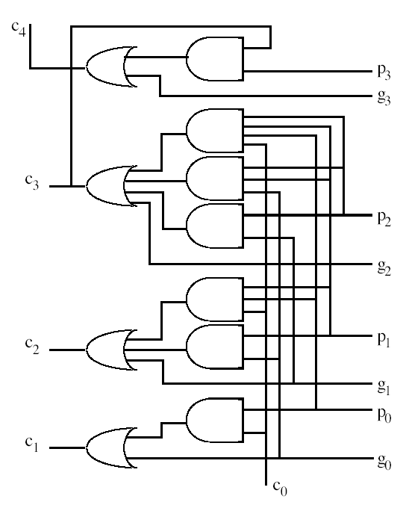
4-bit CLA Logic
A: a₃ a₂ a₁ a₀
B: b₃ b₂ b₁ b₀
g_{i} = a_{i}b_{i}
p_{i} = a_{i} + b_{i}
all carry-bits are generated directly from inputs;
one can thus use independent FA-modules, to produce the sum-bits in parallel!

Slide 53
n-bit CLA Adder
Much faster than RCA
Critical path delay in an n-bit CLA?
Cost = O(?); delay O(?)

Slide 54
Full Carry Lookahead
a₃
b₃
a₂
b₂
a₁
b₁
a₀
b₀
c_{in}
. . .
s₃
s₂
s₁
s₀
Theoretically, it is possible to derive each sum digit directly from the inputs that affect it
Carry-lookahead adder is impractical for large n

Slide 55
n-bit Hybrid CLA Adder
Implementation of lookahead for the complete adder is impractical because of cost
Divide n stages into smaller groups
Full carry lookahead within each group
Ripple carry among groups

Slide 56
12-Bit Hybrid (CLA + RCA)
A=
1101
1001
1010
B=
0111
0110
1101
A₁₁
A₁₀
A₉
A₈
A₇
A₆
A₅
A₄
A₃
A₂
A₁
A₀
B₁₁
B₁₀
B₉
B₈
B₇
B₆
B₅
B₄
B₃
B₂
B₁
B₀
p,g
p,g
p,g
p,g
p,g
p,g
p,g
p,g
p,g
p,g
p,g
p,g
0
C₀
Carry Generator
Carry Generator
Carry Generator
C₁₂
C₈
C₄
S₁₁
S₁₀
S₉
S₈
S₇
S₆
S₅
S₄
S₃
S₂
S₁
S₀
RCA
CLA
Trade-off: cost versus delay
Another solution: 12-Bit Hybrid (RCA + CLA)??
Cost = O(?); delay O(?)
Notes:
The timing is not realistic. I have assumed:
p_i and g_i computations take 1 cycle
Carry generation block take 1 cycle to generate the last carry
Hence, the second row shows T=2 (p,g calc + carry gen), while other rows show 1 cycle (only carry generation)

Slide 57
32-bit Hybrid CLA with 4-bit blocks (CLA + RCA)

Slide 58
CLA principle can be used recursively to build bigger adders => Carry-lookahead tree (CLT)
A 16 bit adder uses four 4-bit adders
It takes block g and p terms and cin to generate block carry bits out
Block carries are used to generate bit carries
could use ripple carry of 4-bit CLA adders
Better: use the CLA principle again!

Slide 59
16-bit 2-level Carry-Lookahead Adder (CLT)
c₁₅
c₁₄
c₁₃
c₁₁
c₁₀
c₉
c₇
c₆
c₅
c₃
c₂
c₁
g₁₄p₁₄
g₁₂p₁₂
g₁₀p₁₀
g₈p₈
g₆p₆
g₄p₄
g₂p₂
g₀p₀
g₁₃p₁₃
g₁₁p₁₁
g₉p₉
g₇p₇
g₅p₅
g₃p₃
g₁p₁
g₁₅p₁₅
c₁₂
c₈
c₄
c₀
CLA GEN
CLA GEN
CLA GEN
CLA GEN
g_{[12,15]}
P_{[12,15]}
g_{[8,11]}
p_{[8,11]}
g_{[4,7]}
p_{[4,7]}
g_{[0,3]}
p_{[0,3]}
CLA GEN
g_{[0,15]}
p_{[0,15]}
(carry-lookahead tree - CLT)
Cost = O(?); delay O(?)

Slide 60
64-bit 3-level Carry-Lookahead Adder (CLT)
c₃₁ c₃₀ c₂₉
c₂₇ c₂₆ c₂₅
c₂₃ c₂₂ c₂₁
c₁₉ c₁₈ c₁₇
c₄₈
c₃₂
c₂₈
c₂₄
c₂₀
c₁₆
c₀
CLA GEN
CLA GEN
CLA GEN
CLA GEN
g_{[28,31]}
g_{[24,27]}
g_{[20,23]}
g_{[16,19]}
p_{[28,31]}
p_{[24,27]}
p_{[20,23]}
p_{[16,19]}
CLA GEN
g_{[48,63]}
g_{[32,47]}
g_{[16,31]}
g_{[0,15]}
p_{[48,63]}
p_{[32,47]}
p_{[16,31]}
p_{[0,15]}
CLA GEN
g_{[0,63]}
p_{[0,63]}

Slide 61
Carry-Select Adders (CSA)
Idea:
Compute sum-bits in parallel for two possible carry-bits;
When the previous carry really arrives, just select the pre-computed “sum”.
CLA: Looking ahead in time (pre-compute carry-bits)
CSA: Looking ahead in space (pre-compute sum-bits)

Slide 62
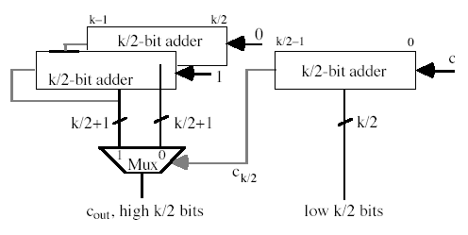

k-bit Carry-Select Adder
carry-out
sum-bits
Units: cost and delay of a single 2-to-1 multiplexer

Slide 63
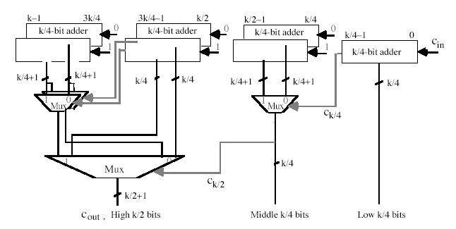
Multi-level k-bit Carry-Select Adder

Slide 64
Pitfalls of CLA Adder
Implementation of lookahead for the complete adder is impractical because of cost
Analyze the implementation complexity of CLA

Slide 65
CS 31007 Autumn 2020 COMPUTER ORGANIZATION AND ARCHITECTURE
Instructors
Rajat Subhra Chakraborty
Bhargab B. Bhattacharya
Week 5, October 01, 2020
Indian Institute of Technology Kharagpur
Computer Science and Engineering
Notes:
Good Morning!
The title of today’s talk is “On some Planar Partitioning Problems”.

Slide 66
So far covered in computer arithmetic…
Number Systems and Overflow
Ripple-Carry Adder (RCA)
Carry-Lookahead Adder (CLA)
Hybrid Adder, CLT
Carry-Select Adder (CSA)
Brent-Kung’s Parallel Prefix Adder (PPA)
Notes:
Good Morning!
The title of today’s talk is “On some Planar Partitioning Problems”.

Slide 67
Carry Lookahead Adder
one AND-gate and
one OR-gate
C₁ = a₀b₀ + (a₀+b₀)c₀ = g₀ + p₀c₀
C₂ = a₁b₁ + (a₁+b₁)c₁ = g₁ + p₁c₁ ₌ g₁ + p₁g₀ ₊ p₁p₀c₀
C₃ = a₂b₂ + (a₂+b₂)c₂ = g₂ + p₂c₂ ₌ g₂ + p₂g₁ ₊ p₂p₁g₀ ₊ p₂p₁p₀c₀
C₄ = a₃b₃ + (a₃+b₃)c₃ = g₃ + p₃c₃ ₌ g₃ + p₃g₂ ₊ p₃p₂g₁ ₊ p₃p₂p₁g₀ ₊ p₃p₂p₁p₀c₀
g_{i} = a_{i}b_{i} p_{i} = a_{i} + b_{i}
inputs
a₃ b₃
a₂ b₂
a₁ b₁
a₀ b₀
g₃
p₃
g₂
p₂
g₁
p₁
g₀
p₀
CLA logic
c₀
c₄
c₃
c₂
c₁
carry-bits

Slide 68
4-bit Carry-Lookahead Adder
c₄ = g₃ + g₂ p₃ + g₁ p₂p₃ + g₀ p₁p₂p₃ + c₀ p₀p₁p₂p₃
inputs
c₃ = g₂ + g₁ p₂ + g₀ p₁p₂ + c₀ p₀p₁p₂
g_{i} = a_{i}b_{i}
p_{i} = a_{i} + b_{i}
c₂ = g₁ + g₀ p₁ + c₀ p₀p₁
c₁ = g₀ + c₀ p₀
c_{n} => last term would be p₀p₁p_{2……..}p_{n-1}
In general, the problem boils down to =>
How to compute efficiently in reasonable cost and time:
x₀ , x₀x₁, x₀ x₁x₂, x₀x₁x₂ x₃, …., x₀x₁ x₂x₃ …x_{n-1}
(Prefix-sum/product problem)

Slide 69
Brent-Kung’s Prefix Tree: Logarithmic-Delay
x
x
x
x
x
x
x
x
x
x
x
x
x
x
x
x
15
14
13
12
11
10
9
8
7
6
5
4
3
2
1
0
Level
1
AND-gate
2
fanout
3
delay = O(log n);
cost = O(nlog n);
fanout O(n);
4
cost = O(n²log n)?
5
6
s
s
s
s
s
s
s
s
s
s
s
s
s
s
s
s
15
14
13
12
11
10
9
8
7
6
5
4
3
2
1
0
x₀x₁x₂ x₃ x₀ x₁x₂ x₀x₁ x₀
Notes:
- One disadvantage of this adder is the high fanout of the output of C7. Other adder structures like the Kogg-Stone tree are designed to reduce the fanout.

Slide 70
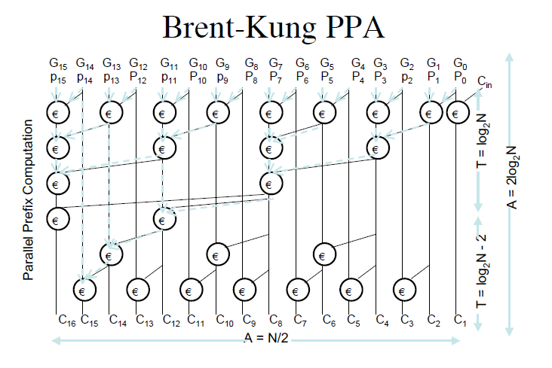
Brent-Kung Parallel-Prefix Adder (log-delay)
delay = O(log n);
cost = O(nlog n);
fanout O(n);
c_{i+1} = g_{i} + c_{i}p_{i}
cost = O(n²log n)?

Slide 71
Carry-Save Addition: Adding multiple operands
Consider adding six set of numbers (4 bits each in the example)
The numbers are 1001, 0110, 1111, 0111, 1010, 0110 (all unsigned +ve)
One way is to add them pair wise, getting three results, and then adding them again
1001 1111 1010 01111 100101
0110 0111 0110 10110 10000
01111 10110 10000 100101 110101
Other method is add them three at a time by saving carry
1001 0111 00000 010101 001101
0110 1010 11110 010100 101000
1111 0110 01011 001100 110101
00000 01011 010101 001101 SUM
11110 01100 010100 101000 CARRY
final sum

Slide 72
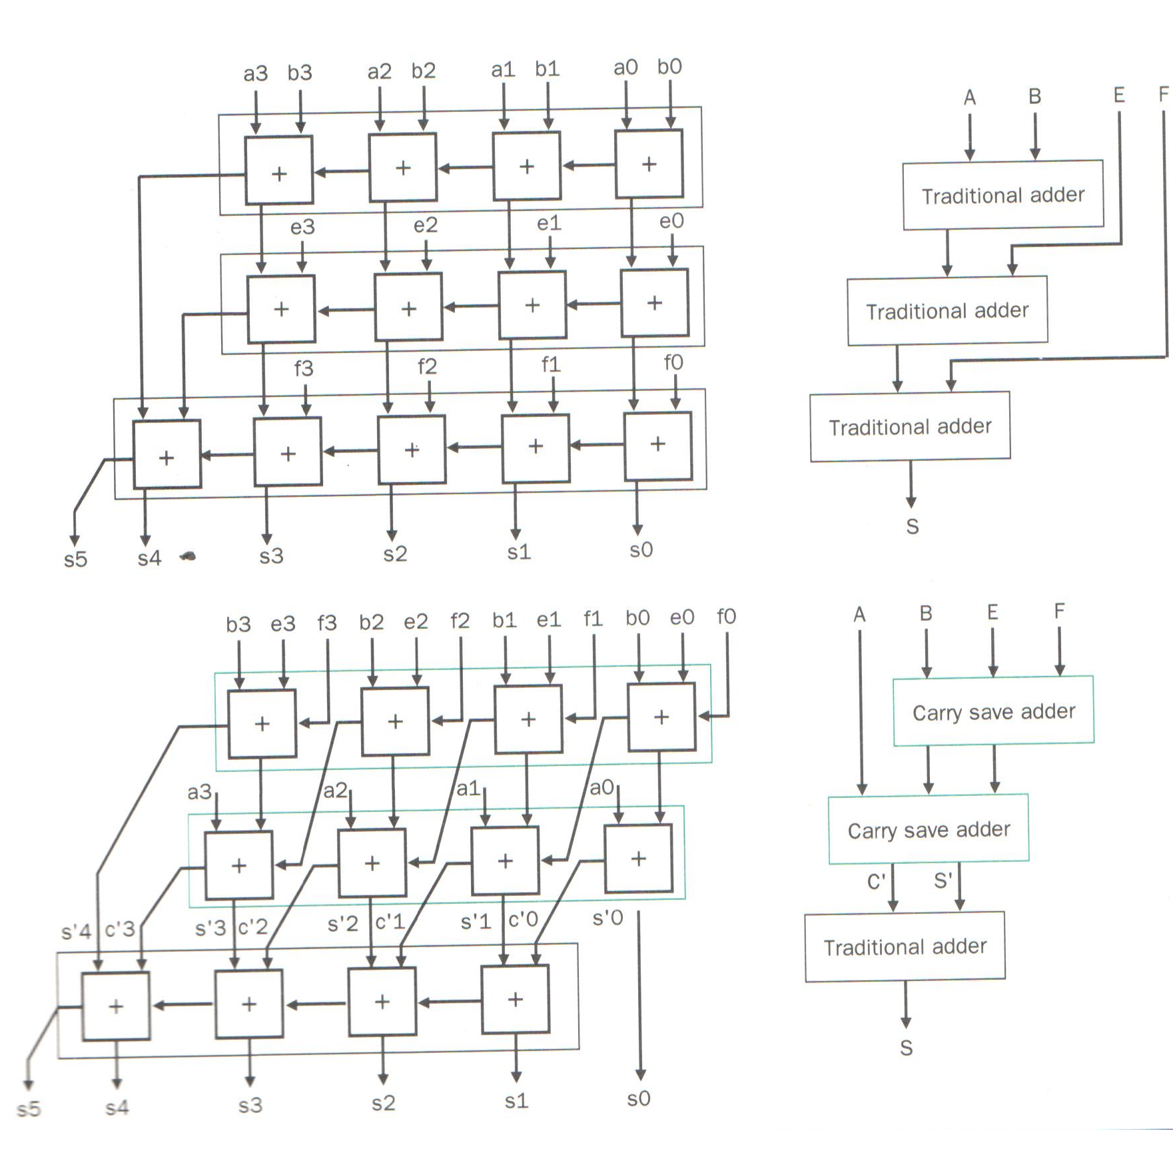
CARRY-SAVE ADDER (addition of multiple operands)
Add four 4-bit integers, A, B, E, F
Cost = O(?); delay O(?)

Slide 73
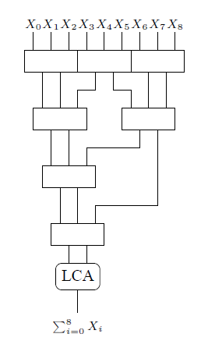
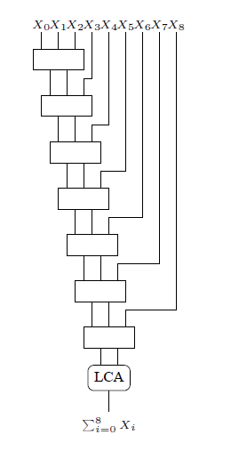
Adding m n-bit numbers with CSA and log-adder
depth = log_{3/2}m
LCA: Lookahead carry adder with log-delay (~CLT)
Wallace tree;
Delay = O(logm + lg (n + logm))
Linear chain;
Delay = O(m + lg (n + m))

